Slide 1

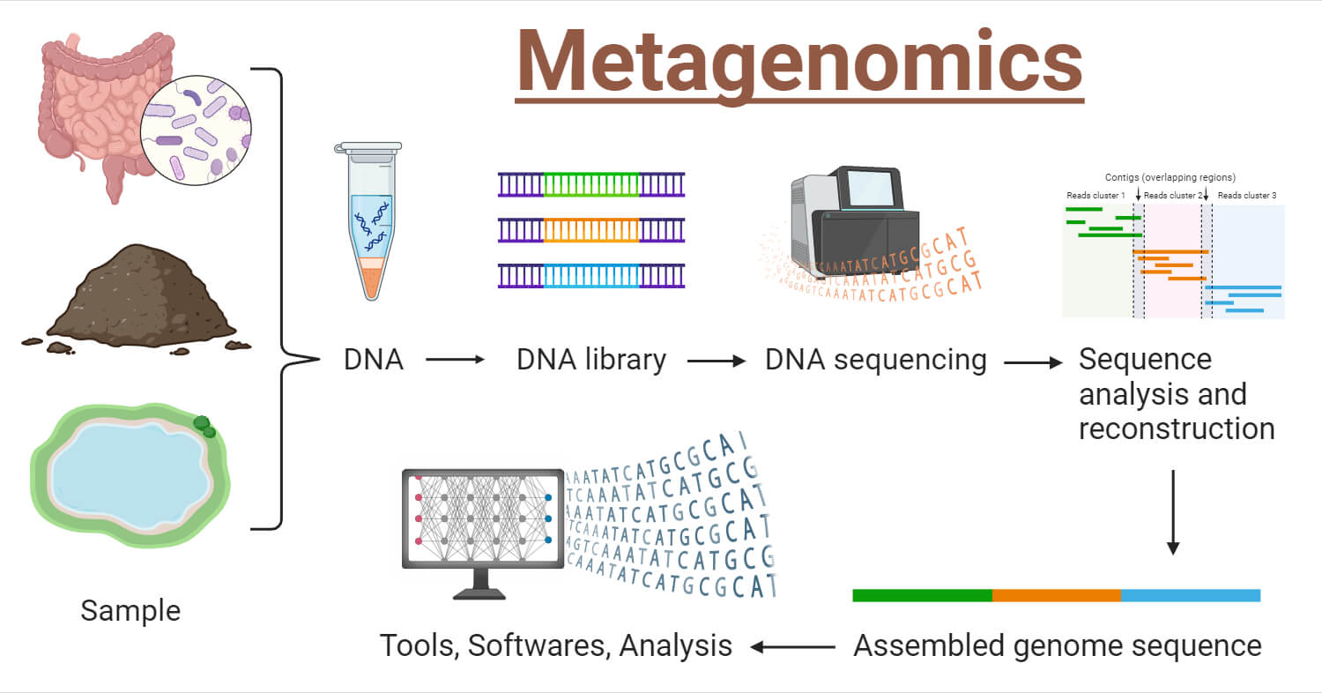


Identification & Characterization of Microbial Diversity in Drinking Water systems using Qiime2
Presented by Group - 6
Beutline Jebin, Deepthi Varughese, Mahesh Rani, Ritwika Nandi, Simmi Kharb, Tanushri Roy, Vidhyashri.
NyBerMan Bioinformatics Europe, France
www.nyberman.com

Slide 2
INTRODUCTION
What is Metagenomics?
Metagenomics is the study of genetic material recovered directly from environmental samples.
Why it is needed?
Provides a complete view of microbial diversity, functions, and interactions in ecosystems.
Objective: To aim of this project is to identify the microbial composition in drinking water samples and characterize them.
NyBerMan Bioinformatics Europe, France
www.nyberman.com

Slide 3
DATA ANALYSIS WORKFLOW
Importing and Demultiplexing sequences
Data Denoising
Alpha and Beta Diversity analysis
Taxonomic classification
Phylogenetic Tree construction
Core Microbiome analysis
Literature review
Conclusion
NyBerMan Bioinformatics Europe, France
www.nyberman.com

Slide 4
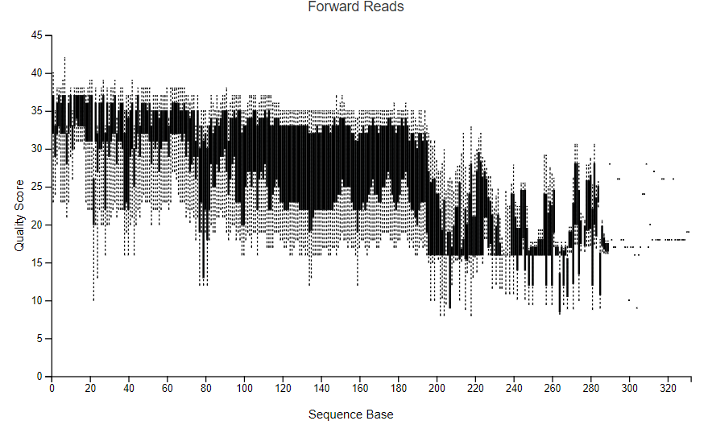
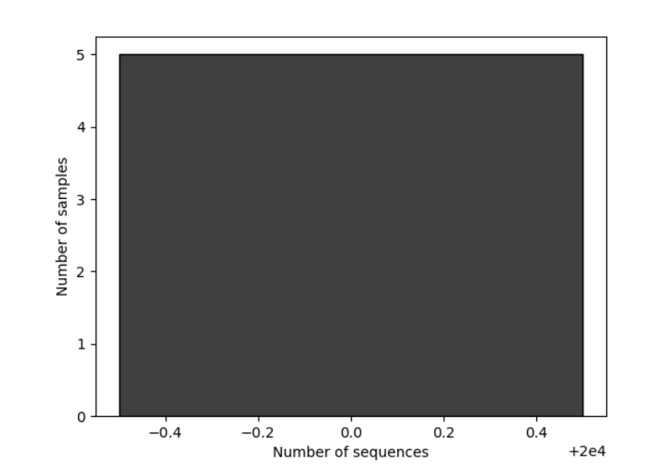
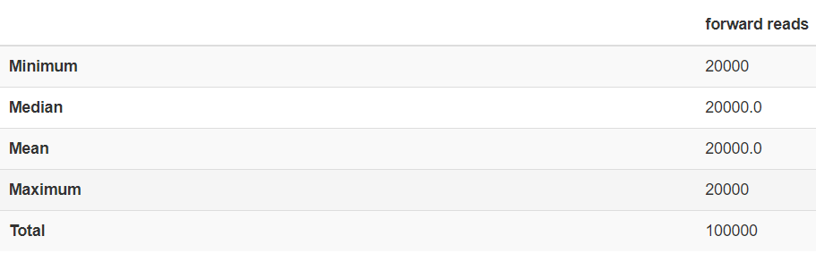
DATA ANALYSIS RESULTS: INTERACTIVE QUALITY PLOT
Forward Reads Frequency Histogram
Demultiplexed sequence counts summary
NyBerMan Bioinformatics Europe, France
www.nyberman.com

Slide 5
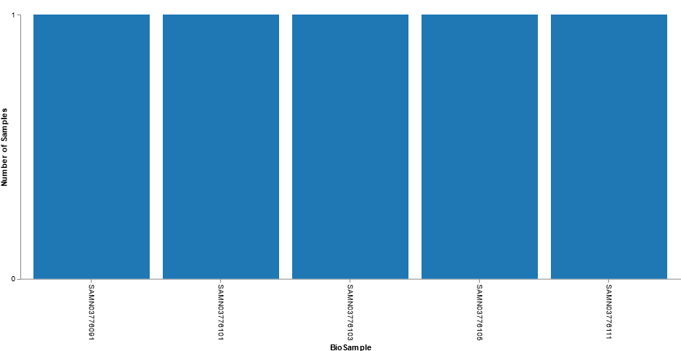
INTERACTIVE SAMPLE ANALYSIS
SAMPLING DEPTH: 11028
Summary Statistic | Value
Number of samples | 5
Number of features | 279
Total frequency | 66,378
NyBerMan Bioinformatics Europe, France
www.nyberman.com

Slide 6
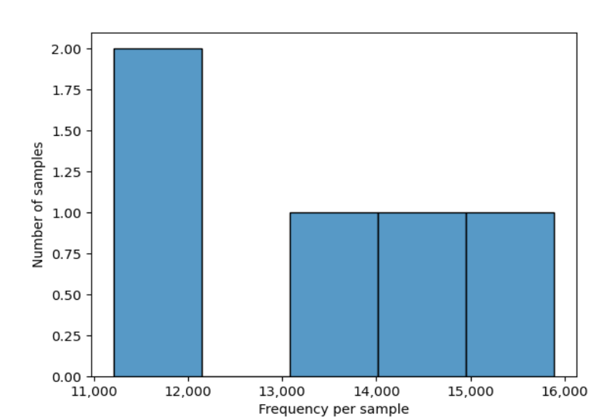
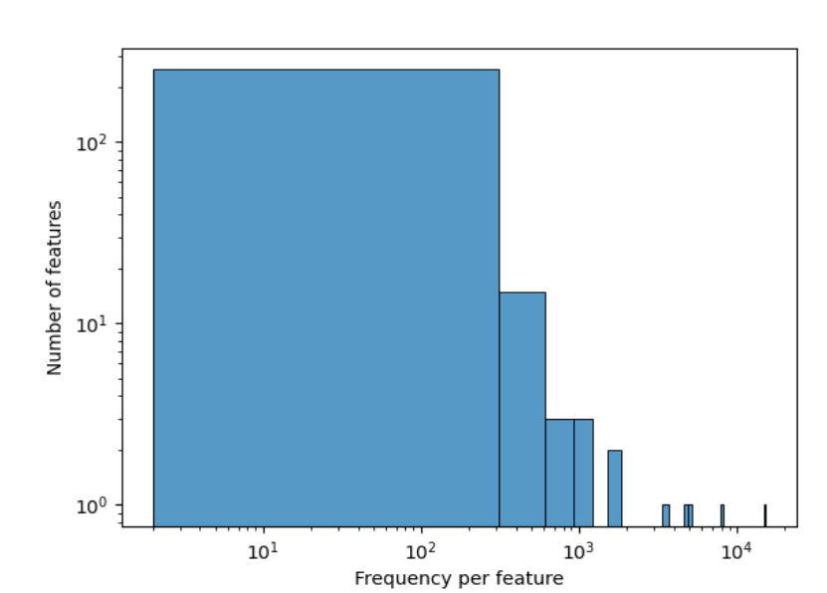
FREQUENCY PER FEATURE AND SAMPLE
NyBerMan Bioinformatics Europe, France
www.nyberman.com

Slide 7
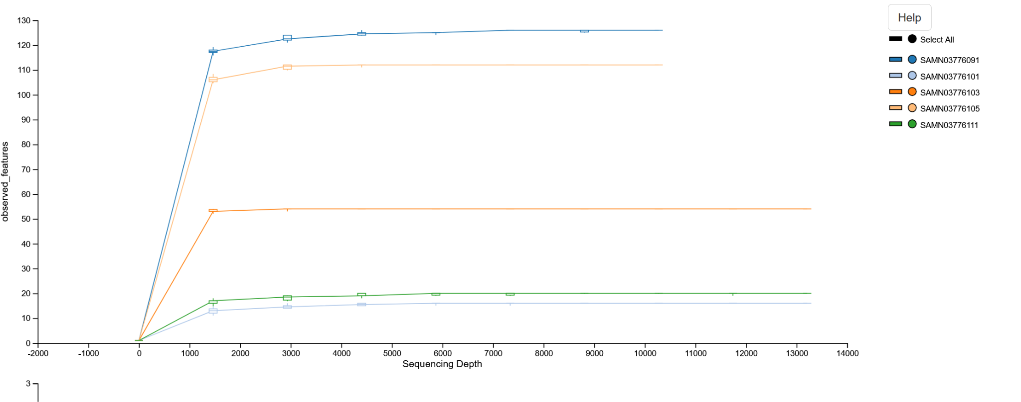
ALPHA RAREFACTION
NyBerMan Bioinformatics Europe, France
www.nyberman.com

Slide 8
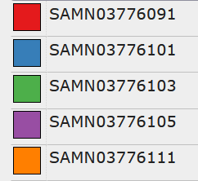
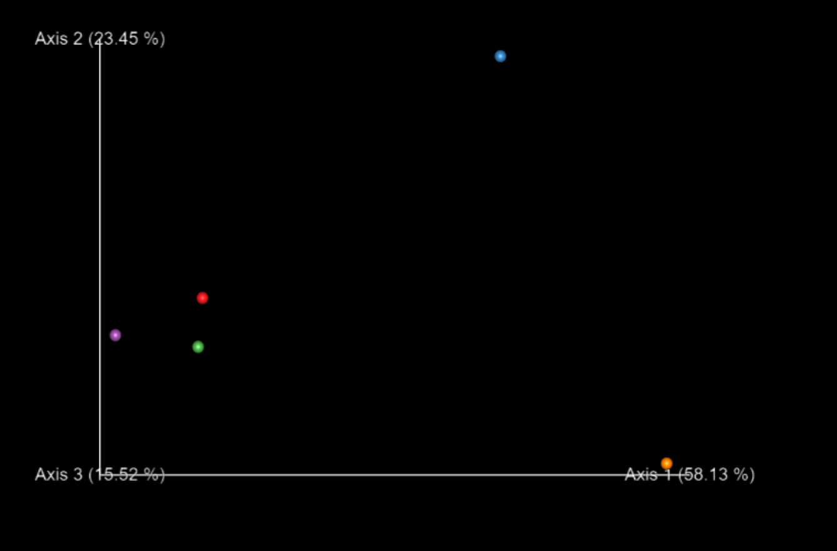
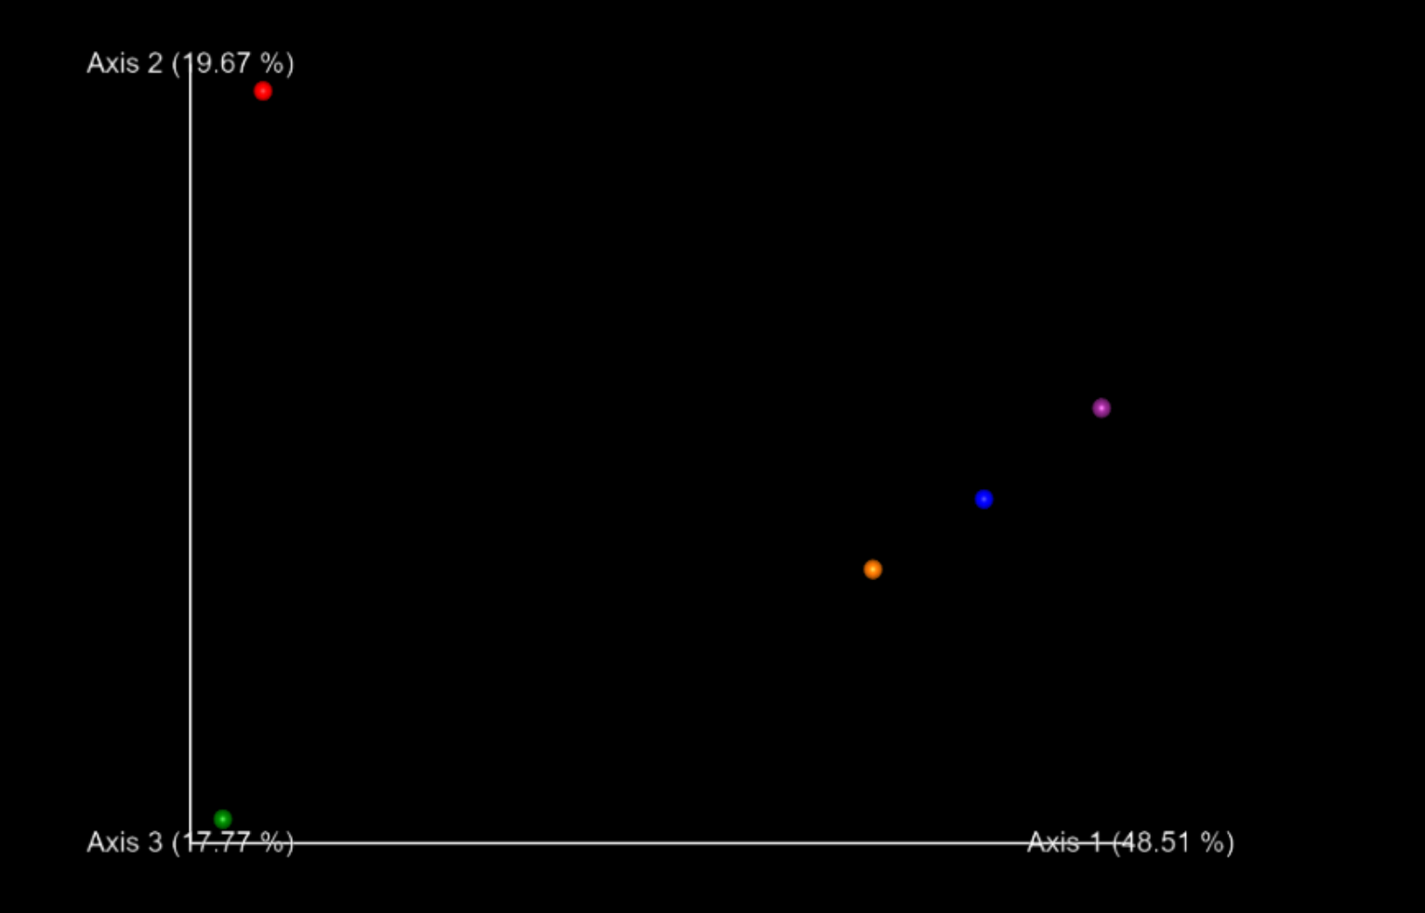
BETA DIVERSITY
Weighted unifrac emperor
Unweighted unifrac emperor
NyBerMan Bioinformatics Europe, France
www.nyberman.com

Slide 9
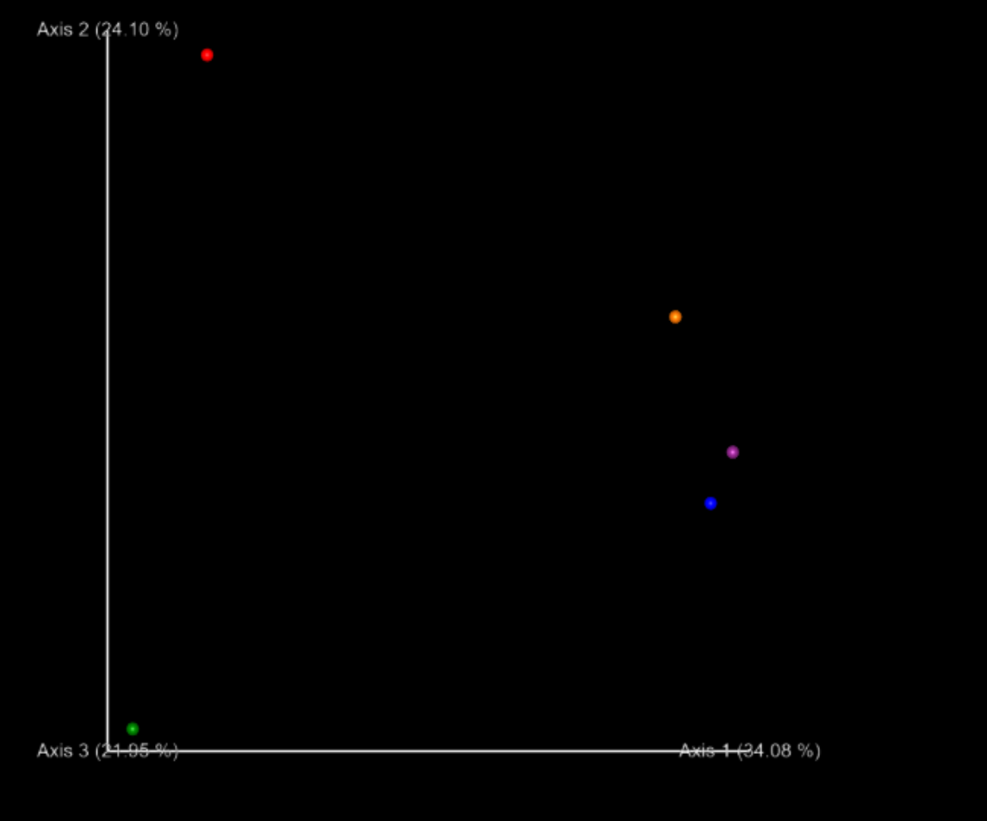

BETA DIVERSITY
Jaccard emperor
Bray curtis emperor
NyBerMan Bioinformatics Europe, France
www.nyberman.com

Slide 10
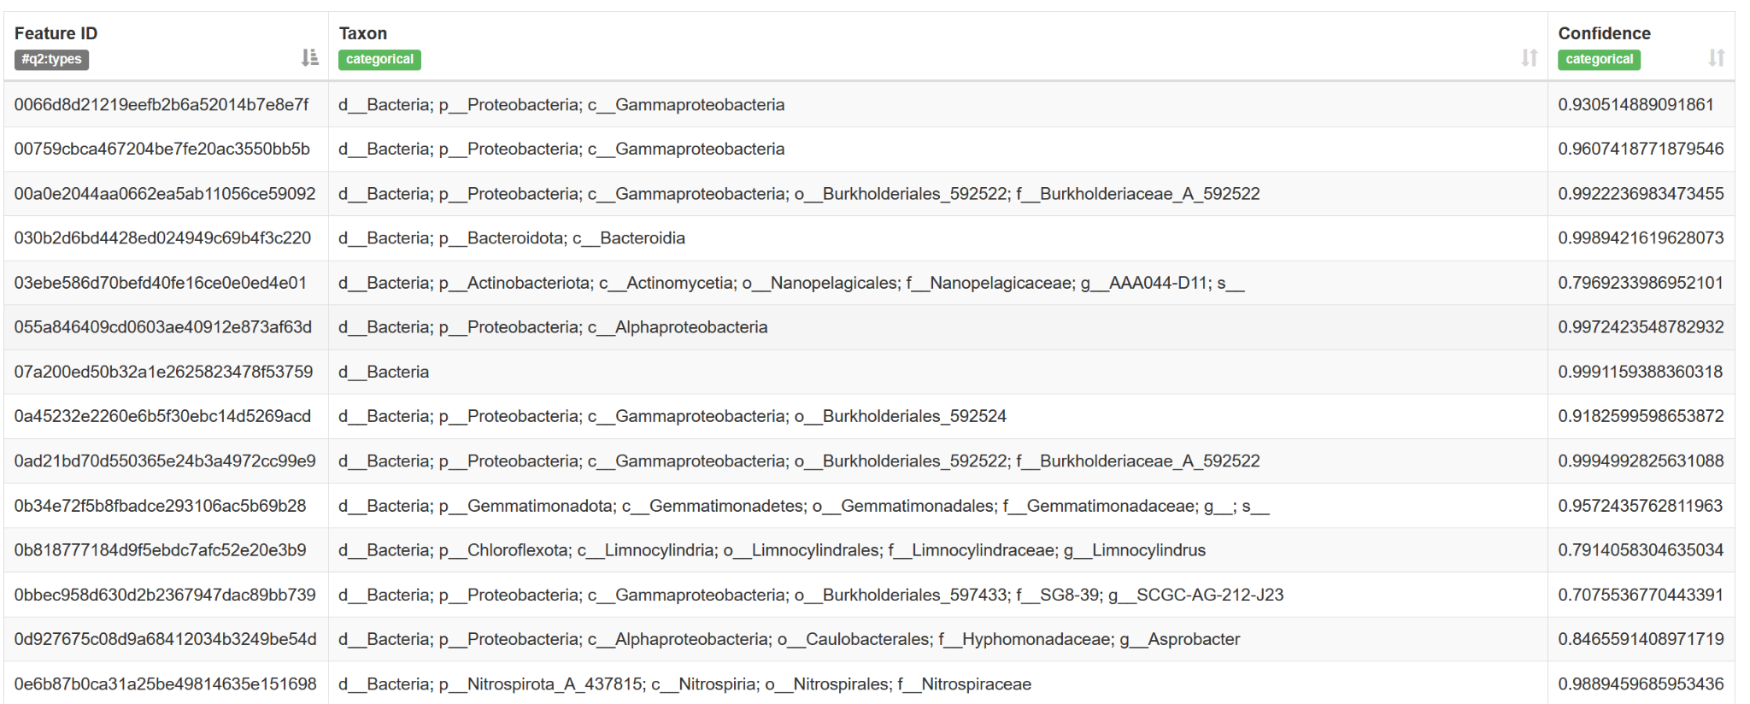
TAXONOMIC CLASSIFICATION (Green genes classifier 2-2022)
Total Entries :279
NyBerMan Bioinformatics Europe, France
www.nyberman.com

Slide 11
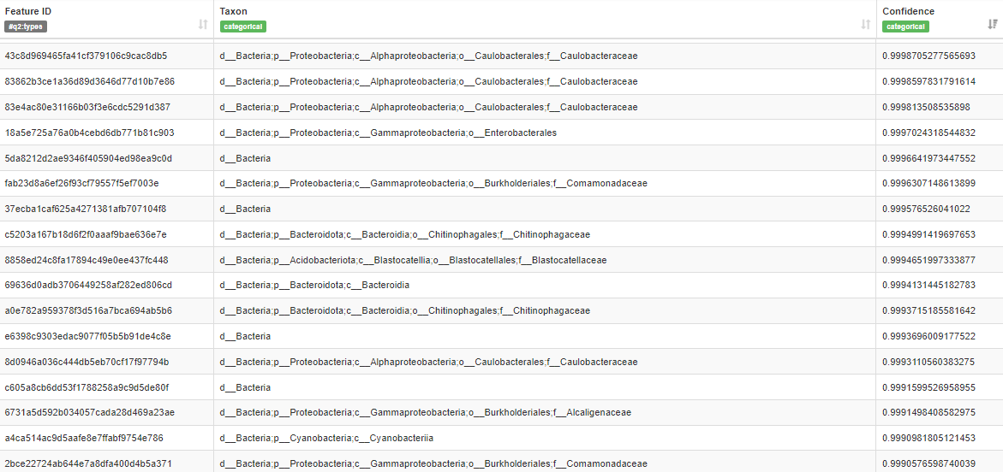
TAXONOMIC CLASSIFICATION (silva-138-99-nb-classifier)
Total entries: 246
NyBerMan Bioinformatics Europe, France
www.nyberman.com

Slide 12
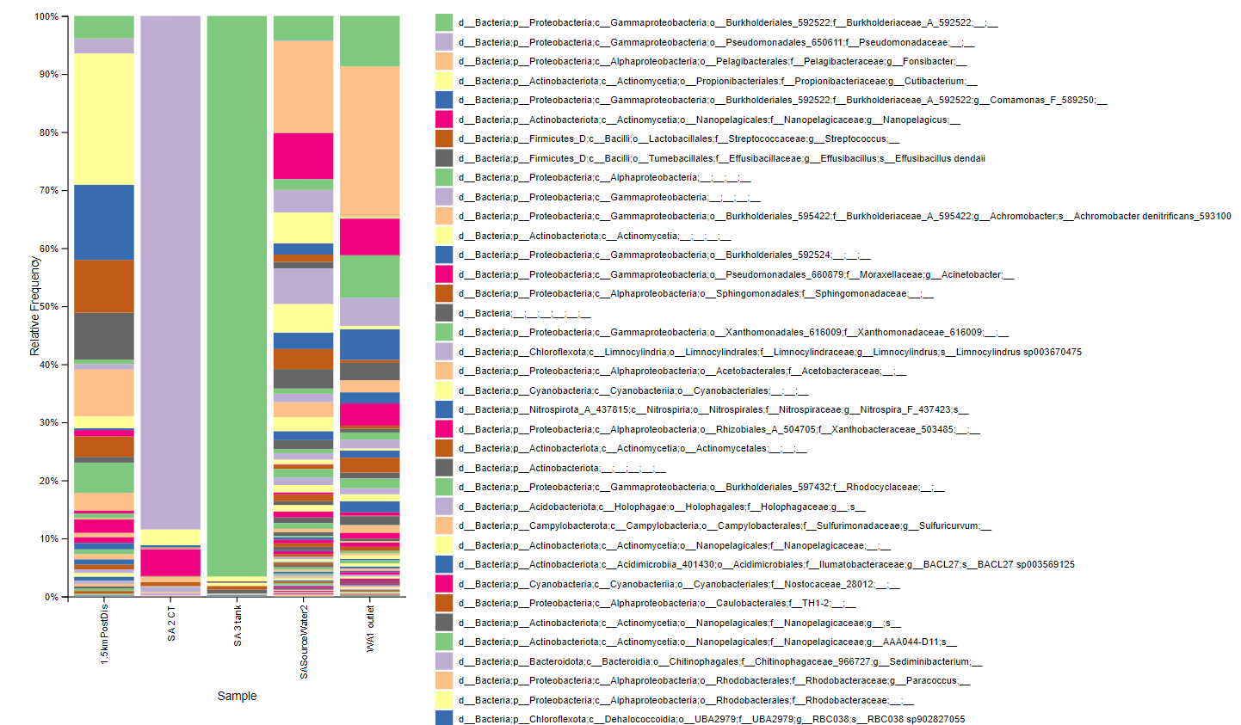
TAXONOMY BAR PLOT (Green genes classifier 2-2022)

Slide 13
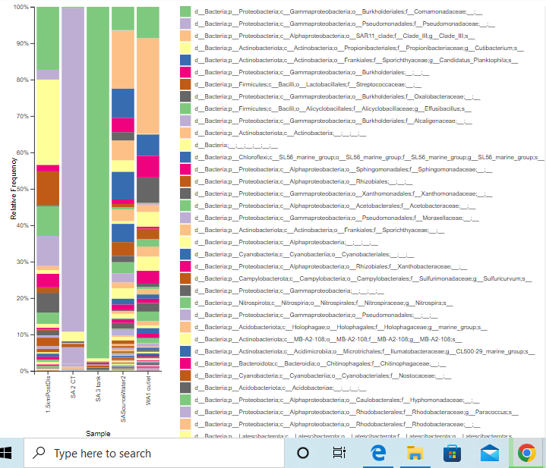
Taxonomy-bar plot (silva-138-99-nb-classifier.qza

Slide 14
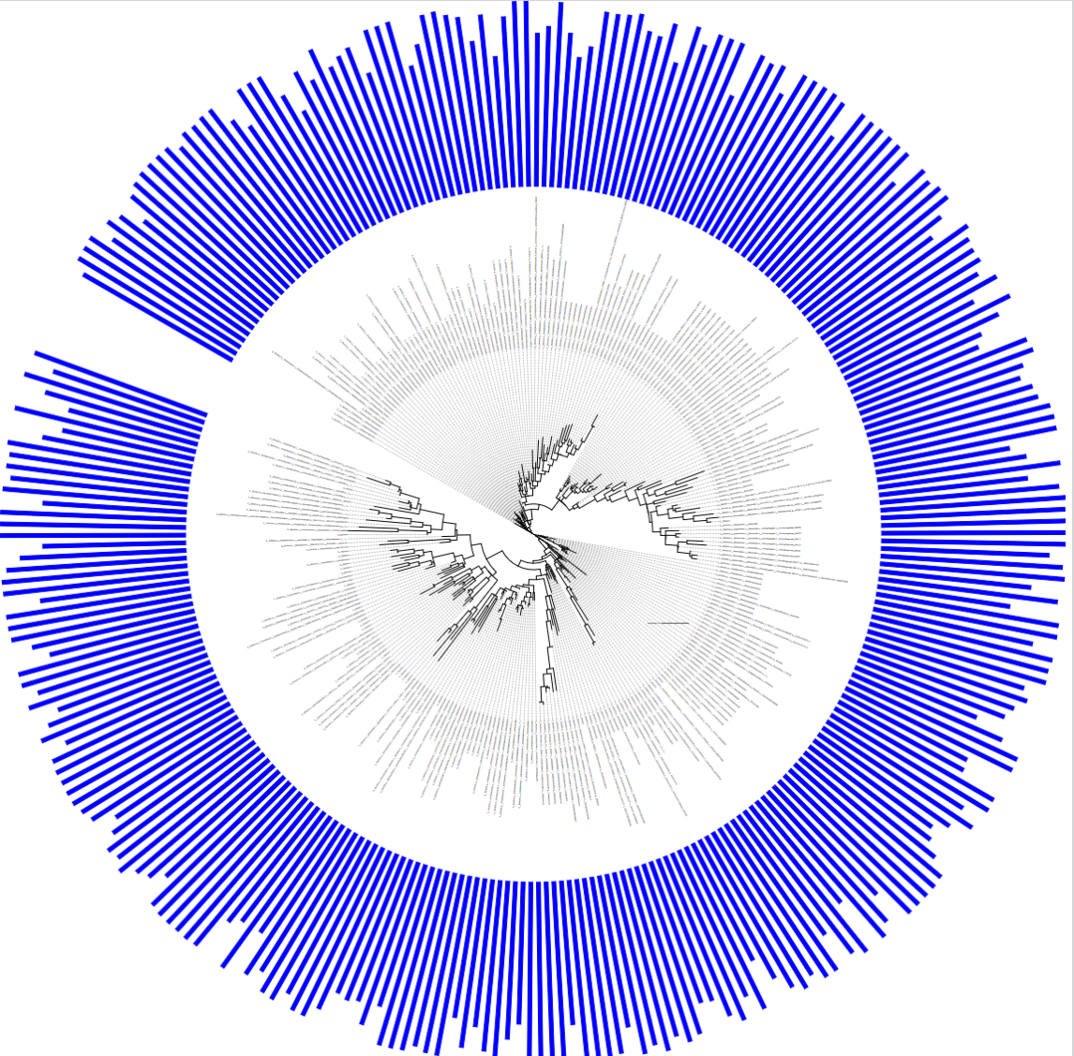
PHYLOGENETIC TREE (Green genes classifier 2-2022)
AMONG 279 MICROBIAL COMMUNITIES, WE FOUND 11 SPECIES AND 27 GENERA !!!
https://docs.google.com/spreadsheets/d/1ANFnf_CapF546w96N14HqsXGkbW3ylKP41kiyplTLQU/edit?gid=0#gid=0

Slide 15
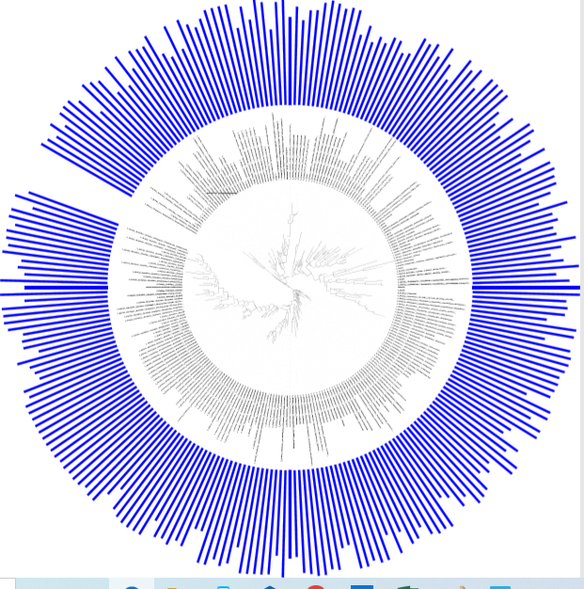
PHYLOGENETIC TREE (silva-138-99-nb-classifier.qza)
AMONG 246 MICROBIAL COMMUNITIES, WE FOUND 50 GENERA !!!
BUT NO SPECIES LEVEL CLASSIFICATION..

Slide 16
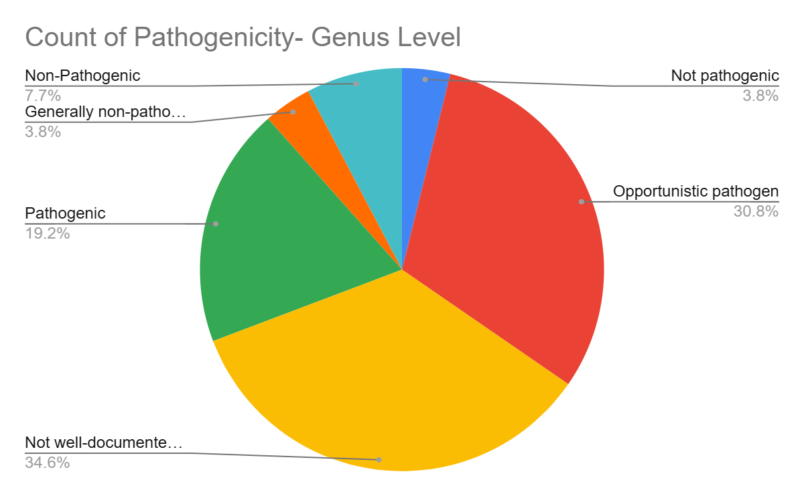
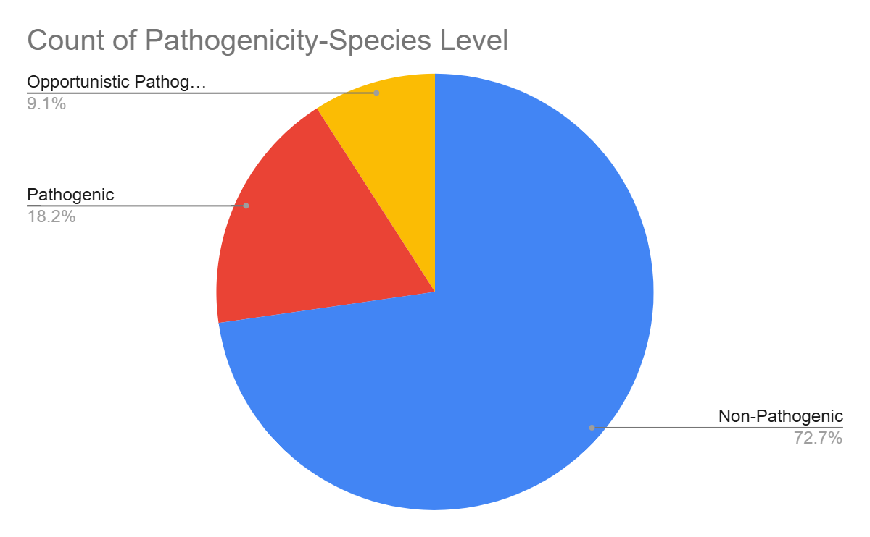
Literature Review on Pathogenecity(Green genes classifier 2-2022)
NyBerMan Bioinformatics Europe, France
www.nyberman.com

Slide 17
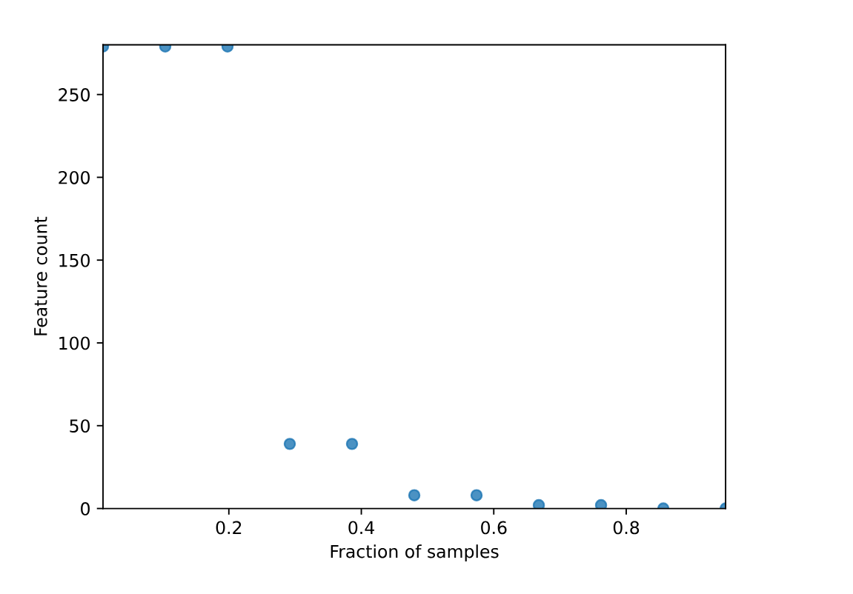
CORE MICROBIOME ANALYSIS
Core features
Feature table summary
Sample count: 5
Frequency: 279
Parameters used
--p-min-fraction 0.01
--p-max-fraction 0.95
NyBerMan Bioinformatics Europe, France
www.nyberman.com

Slide 18
Most abundant microbes identified using both greengene and Silva classifiers
Identified microbes | Significance
Bacteria – Proteobacteria – Gammaproteobacteria – Burkholderiales – Burkholderiacaea - Commamonas | significant role in the biodegradation of pollutants ecological importance potential applications in wastewater treatment and bioremediation strategies
Bacteria – Proteobacteria - Gammaproteobacteria-Pseudomonodales - Pseudomonadaceae | presence in contaminated environments and wastewater-irrigated soils water contamination and microbial regrowth in treated water systems

Slide 19
Most abundant microbes identified using both Greengene and Silva classifiers at the genus level
Identified microbes | Significance
Bacteria – Actinobacteriota – Actinobacteria – Propionibacteriales – Propionibacteraceae – Cutibacterium | Cutibacterium, a genus within the Propionibacteriaceae family, is primarily known for its presence on human skin and its involvement in skin microbiota. Its presence serves as an indicator of broader microbial contamination in environments with significant human activity or pollution
Bacteria - Proteobacteria – Alphaproteobacteria – Pelagibacteriales – Pelagibacteraceae - Fonsibacter | crucial for the health of marine ecosystems changes in their population reflect broader issues related to water quality and contamination. Adaptability to various environmental conditions and contributions to microbial community dynamics underscore their importance in maintaining water quality and ecosystem health potential for bioremediation and the natural attenuation of pollutants.

Slide 20
CONCLUSION
Identified Microbial Diversity: 279 (green genes DB) and 246 (Silva DB) microbial communities were detected at both genus and species for green gene levels & only genus level for Silva in drinking water samples.
Greengene vs Silva based classifier: The Greengenes-based classifier provided species-level classification, whereas the SILVA-based classifier only achieved genus-level classification.
Pathogenic vs. Non-Pathogenic: Some microorganisms were identified as pathogenic, while others were non-pathogenic or beneficial.
Roles in Water Systems: Many microbes contribute to biofilm formation, nutrient cycling, and environmental degradation.
Public Health Implications: Emphasizes the importance of monitoring microbial contamination in drinking water to protect public health.
Need for Continued Surveillance: Highlights the necessity of ongoing surveillance and advanced water treatment to address potential health risks.
NyBerMan Bioinformatics Europe, France
www.nyberman.com

Slide 21
FUTURE DIRECTIONS
Enhanced Monitoring: Implement advanced metagenomic techniques for real-time monitoring of microbial communities in drinking water systems.
Pathogen Detection: Develop more precise methods for early detection of emerging pathogens and antibiotic-resistant bacteria.
Public Health Integration: Integrate metagenomic data with public health surveillance to predict and prevent waterborne disease outbreaks.
NyBerMan Bioinformatics Europe, France
www.nyberman.com

Slide 22
ACKNOWLEDGEMENT
We would like to express our sincere gratitude to the Nyberman Bioinformatics Europe Team for providing this amazing internship on Metagenomics. The knowledge and experience gained through this program have been invaluable.
We are especially thankful to Maya Jayachandran mam for being an outstanding tutor throughout the internship. Your guidance, and dedication have greatly enriched our learning experience.
NyBerMan Bioinformatics Europe, France
www.nyberman.com

